Slide 1
ENGR 181W
https://www.unl.edu/gradstudies/connections/scientific-writing
https://www.iup.edu/writingcenter/writing-resources/organization-and-structure/creating-an-outline/
https://www.monmouth.edu/resources-for-writers/documents/transitions.pdf/
https://www.emmelaw.com/wp-content/uploads/2018/04/What-makes-a-good-document.pdf
Eunson, Baden. Communicating in the 21st Century, 4th Edition. John Wiley & Sons, 2015. Print.

Slide 2
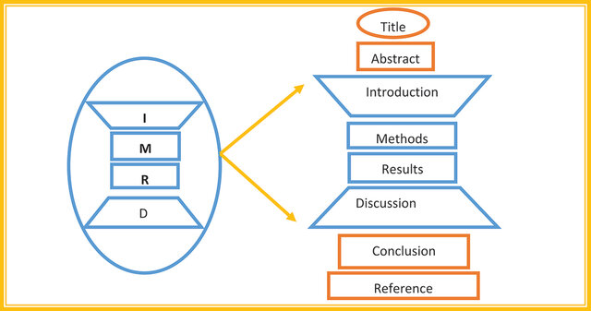
Structure of Technical Documents
Organizing Information
-- Importance of structure in technical writing.
Common structures:
Introduction,
Methodology,
Results,
Discussion,
Conclusion (IMRaD).
-- The pyramid principle for presenting complex information.

Slide 3
A sample IMRaD (Introduction, Methods, Results, and Discussion)-style paper about the function of a Raspberry Pi
The Function of a Raspberry Pi in Modern Computing Applications
Introduction
The Raspberry Pi is a low-cost, credit-card-sized computer developed by the Raspberry Pi Foundation with the goal of promoting computer science education and accessibility. Since its release in 2012, it has gained widespread popularity in educational, hobbyist, and professional circles due to its affordability, versatility, and extensive community support. This paper aims to examine the functions of the Raspberry Pi, highlighting its applications in computing tasks such as data processing, automation, and Internet of Things (IoT) integration.

Slide 4
Results
The Raspberry Pi successfully executed basic desktop computing tasks with acceptable performance, especially on newer models with increased RAM and processing power. GPIO interfacing allowed seamless communication with external sensors, motors, and LEDs. The Raspberry Pi also functioned effectively as a lightweight server and IoT controller. Media playback was smooth with Kodi on the Pi 4, supporting 1080p streaming. Average power consumption remained below 5 W in most scenarios, demonstrating the device's energy efficiency.

Slide 5
Results

Slide 6
Discussion
The Raspberry Pi proves to be a versatile computing platform capable of serving numerous functions. Its GPIO pins allow direct interfacing with the physical world, making it ideal for prototyping electronics and automation projects. The ability to run a full Linux-based OS enables use in more traditional computing roles, such as programming, office tasks, and hosting services. While not intended for high-performance computing, its balance of cost, functionality, and energy efficiency makes it a powerful tool for education, DIY projects, and light professional applications.

Slide 7
Conclusion
The Raspberry Pi is a multifunctional microcomputer with capabilities that extend far beyond its price point. Its small size, flexibility, and support for various software applications position it as a key component in learning environments and embedded system development. Future iterations of the Raspberry Pi are expected to further expand its computing power and functional range, solidifying its role in the broader computing ecosystem.

Slide 8
The pyramid principle for presenting complex information
The Pyramid Principle is a communication framework developed by Barbara Minto at McKinsey & Company.
It's designed to help you present complex ideas clearly, logically, and persuasively—especially in business or analytical writing and presentations.
Core Idea:
The Pyramid Principle suggests that you should start with the main message or conclusion first, then support it with logical arguments, and finally provide detailed evidence.
The structure looks like an inverted pyramid, hence the name.

Slide 9

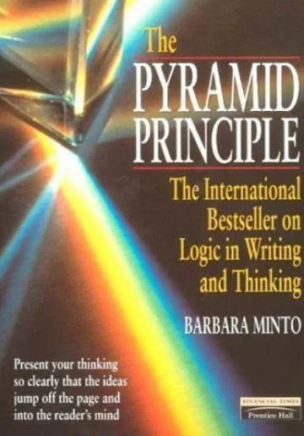
Minto published her book, The Pyramid Principle: Logic in Writing and Thinking, in 1985, and an upgraded edition entitled The Minto Pyramid Principle: Logic in Writing, Thinking and Problem Solving in 1996.
Minto graduated from Harvard Business School in 1963.
She was one of only eight women to graduate in a class of 600.

Slide 10
1. Recommending a Phone to a Friend
Main Idea (Top of the Pyramid): “You should get the XYZ smartphone”
Supporting Reasons:
It has great battery life.
The camera is excellent.
It fits your budget.
Supporting Evidence:
Battery lasts up to 2 days with regular use.
Camera includes night mode and cinematic video.
It’s currently on sale for $599.

Slide 11
2. Pitching a New Dinner Plan
Main Idea: “Let’s have spaghetti for dinner tonight.”
Supporting Reasons:
It’s quick and easy to make.
We already have all the ingredients.
Everyone in the family likes it.
Evidence:
Takes 20 minutes to cook.
We’ve got pasta, sauce, and ground beef.
Kids asked for it last week.

Slide 12
The pyramid principle for presenting complex information
Basic Structure:
1. Top of the Pyramid – The Main Message
o This is your key takeaway or recommendation.
o Think of it as your answer to the audience’s implied question: “So what?”
2. Middle – Supporting Arguments (Grouped Logically)
o These are 2–4 reasons or points that support your main message.
o They should be grouped in a way that makes logical sense (e.g., chronologically, by category, or by importance).
3. Base – Evidence/Details
o Here’s where you provide facts, data, and examples that back up each supporting point.

Slide 13
Why It Works: • Clarity: It forces you to clarify your thinking. • Efficiency: You get to the point quickly—ideal for busy readers or listeners. • Logic: It builds arguments in a way that feels natural and convincing.

Slide 14
Example 1:
Let’s say you’re recommending your company switch to a new software.
• Main Message: We should adopt Software X for our project management needs.
Support 1: It will improve team collaboration (evidence: survey data, user feedback).
Support 2: It’s more cost-effective than our current tool (evidence: pricing comparison).
Support 3: It integrates seamlessly with our existing systems (evidence: IT analysis).

Slide 15
Example 2: Environmental and Ethical Aspect of Lithium –ion Batteries
Top of the Pyramid – Main Message (Thesis Statement):
While lithium-ion batteries are crucial for transitioning to clean energy, they raise serious environmental and ethical concerns that must be addressed to ensure a truly sustainable future.

Slide 16
Example 2: Environmental and Ethical Aspect of Lithium –ion Batteries
Middle of the Pyramid – Supporting Arguments (Grouped Logically):
1. Environmental Impact of Lithium Extraction and Disposal
Mining for lithium consumes vast amounts of water and can lead to ecosystem destruction.
Battery production has a large carbon footprint.
Improper disposal leads to toxic waste and pollution.
2. Ethical Concerns in the Supply Chain
Many raw materials (e.g., cobalt) are mined under poor labor conditions, often involving child labor.
There’s a lack of transparency and accountability in sourcing practices.
Communities near mining sites often face displacement and health hazards.
3. Need for Regulation, Recycling, and Innovation
Stronger environmental and labor regulations are needed globally.
Battery recycling and second-life programs can reduce resource pressure.
Research into alternatives (like solid-state batteries or sodium-ion) could offer cleaner, more ethical solutions.

Slide 17
Example 2: Environmental and Ethical Aspect of Lithium –ion Batteries
Bottom of the Pyramid – Supporting Evidence:
Each of the above points would be expanded with:
• Facts and statistics (e.g., water usage in lithium triangle countries)
• Case studies (e.g., cobalt mining in the DRC)
• Quotations from experts or reports (e.g., Amnesty International, UN, IEA)
• Graphs or charts (if it's a presentation)

Slide 18
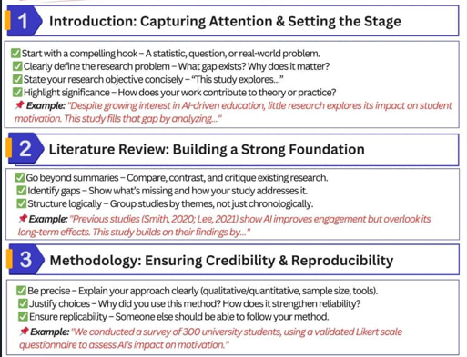
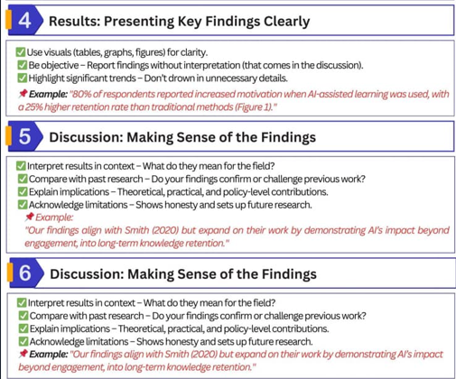

Slide 19
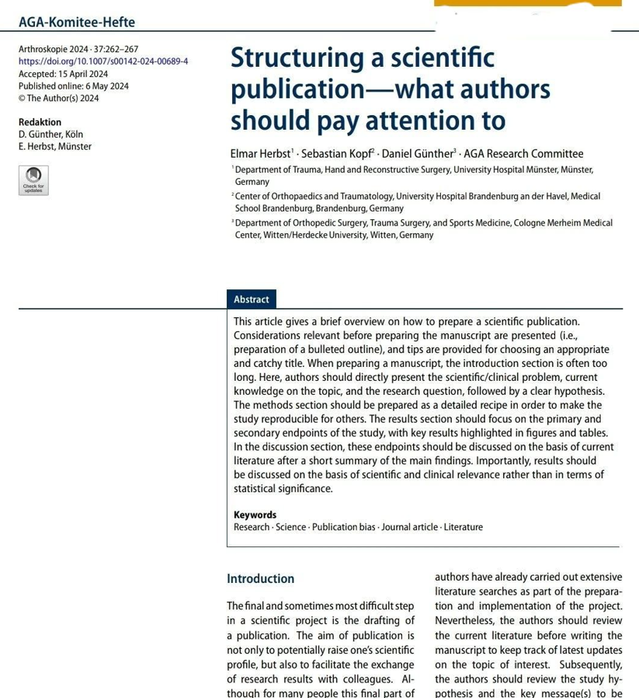

Slide 20
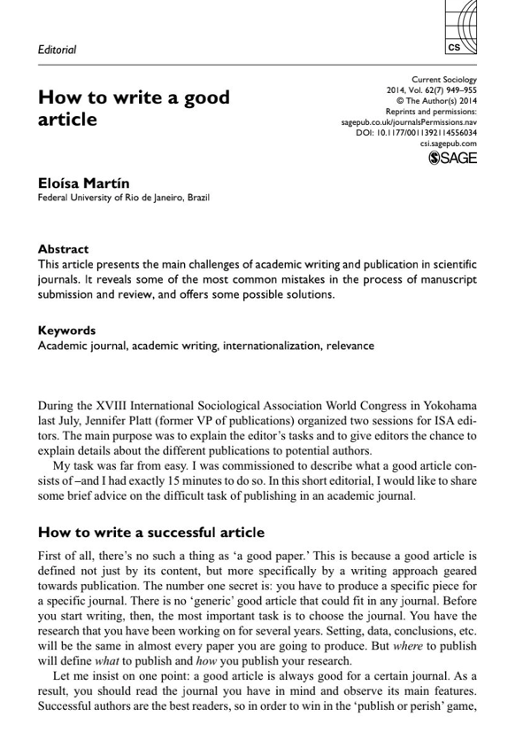

Slide 21
What is scientific writing? Scientific writing is not just writing about science. Scientific writing is a type of technical writing that researchers and scientists write about their studies and share it with others.
This is a summary of an interview with Dr. Rick Lombardo from the Office of Graduate Studies of University of Nebraska-Lincoln https://www.unl.edu/gradstudies/connections/scientific-writing

Slide 22
Scientific writing must reflect the same precision of the research process. Scientific communication demands: - Precision - the precise use of words and phrases - Clarity, and - Economy

Slide 23
Technical Writing | Academic/Scientific Writing
Technical writing focuses on providing detailed and simple information about the product or service. | Academic writing focuses on proving a theory or viewpoint in one way or the other and emphasizes upon one specific subject.
Technical writing contains factual and straight forward content. | Academic writing contains contents on specific discipline or field.

Slide 24
Technical Writing
Academic Writing
Own or personal point views are not included. | Own or personal point of view may be included.
Its purpose is getting something done. | Its purposes is to demonstrate what a person knows.
In technical writing the knowledge of topic is more than the reader who is going through it. | In academic writing the knowledge of topic is less than the teacher who is evaluating the topic.

Slide 25
Rules for Scientific Writing
• Interest, inform, and persuade the reader
• Write for your reader and write clearly
• Eliminate unnecessary redundancy
• Don't over explain and avoid overstatement
• Use consistent tenses
• Use the precise word
• Simpler words are preferred over complex words
• Simpler sentences are preferred over more complicated sentences
• Use the active voice (except generally in methods)
• Make sure the subject and verb agree
• Use affirmative rather than negative constructions
• Avoid use of the indefinite "this"
• Use transitions
• Cite sources as well as findings
• Proofread your paper carefully; spell check does not catch everything; "there" is spelled correctly but not if you meant "their"

Slide 26
Physics letters B, 2018, Vol.783 (C), p.392-414

Slide 27
Research article Full text access
Robot control systems: A survey
Mary M. Moya, Homayoun Seraji
September–December 1987

Slide 28
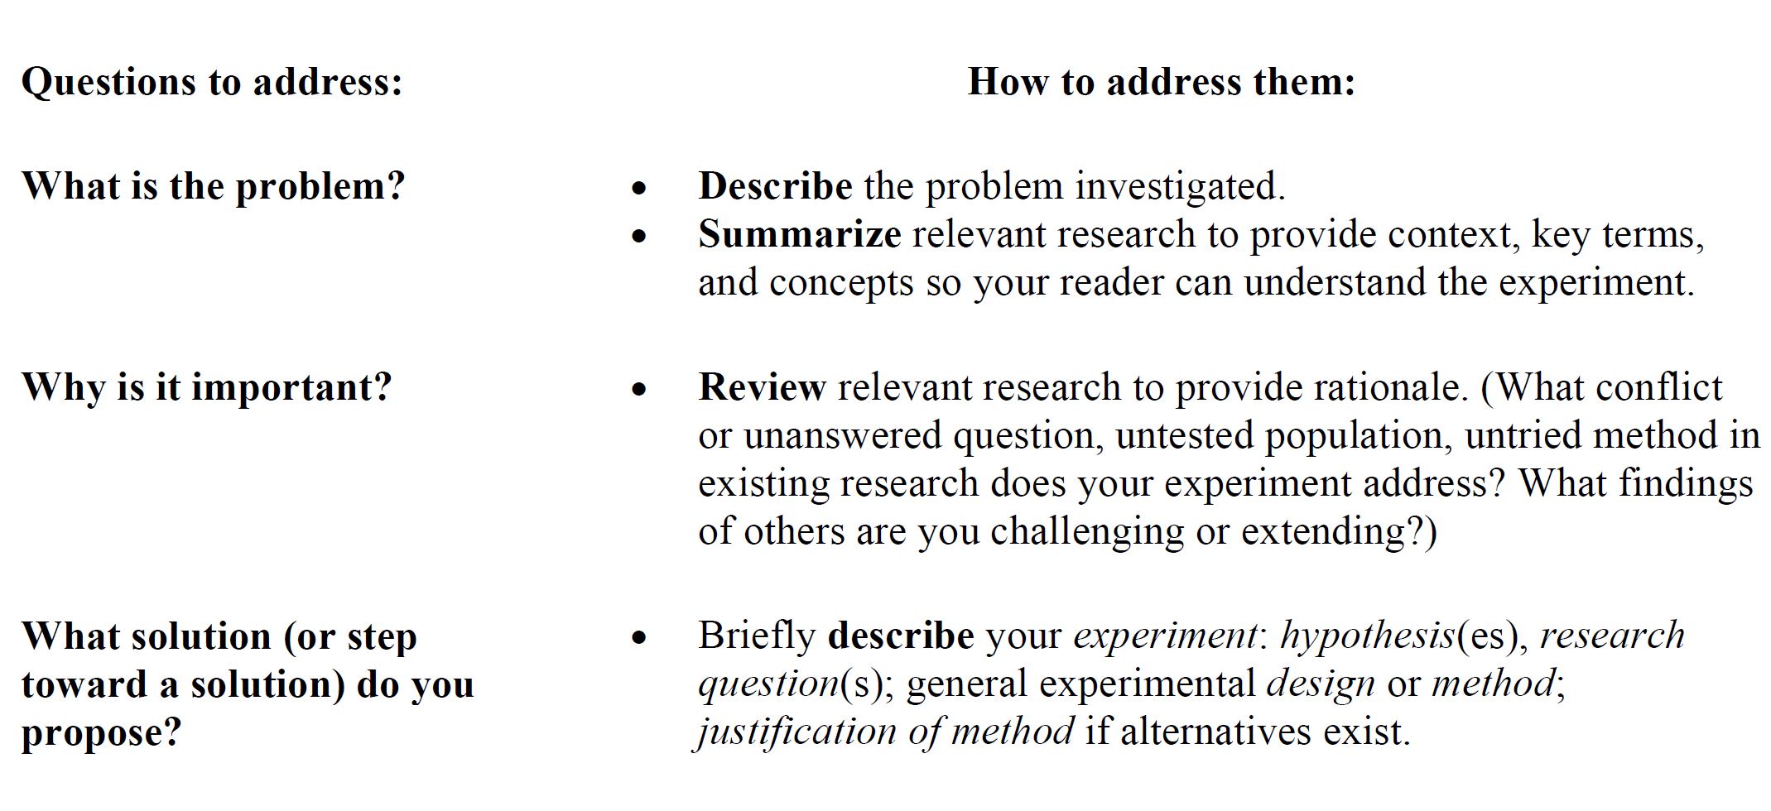

Slide 29
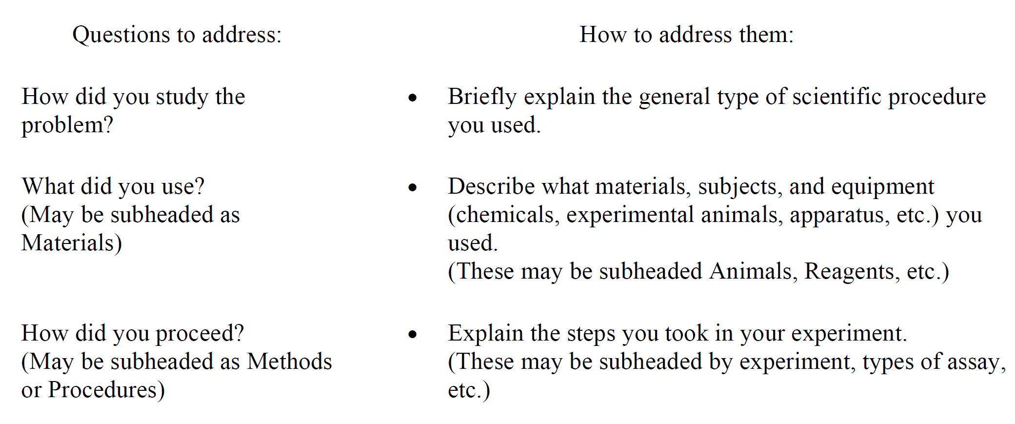

Slide 30
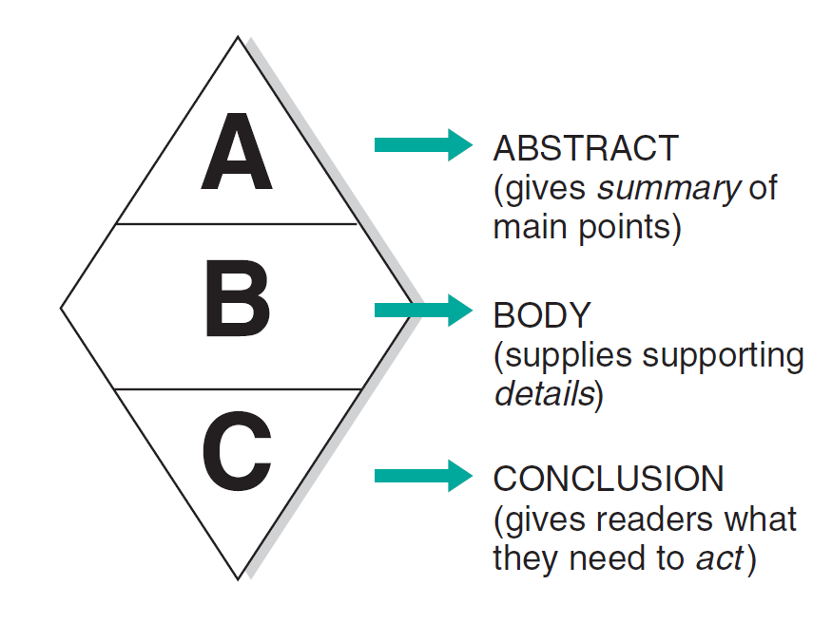
Document Abstract: The “Big Picture” for Decision Makers
Document Body: Details for All Readers
Document Conclusion: Wrap-Up Leading to Next Step

Slide 31
Scientific / technical writing: Highly technical information - For people who may, or may not, be as knowledgeable - They may, or may not, be a native speaker - The research question, hypotheses, methods, analysis, and conclusions must be stated clearly and simply. - Facts, figures, and methods used in research must be precise and exact - Description of the results must be precise and exact

Slide 32
Accurate words and punctuation: “Isotopes, which were discovered in 1853, are radioactive,” reads as if all isotopes were discovered in 1853. The writer intended to say: “The isotopes that were discovered in 1853 are radioactive.”

Slide 33
The organization of writing Readability: If your reader has to work too hard to understand your meaning or your organization, you have a problem in your writing. Remember, you are not writing to impress. You are writing to communicate.

Slide 34
Logic and organization: Two important pillars of technical/scientific writing - In face-to-face explanation you can get an instant feedback - In writing you have only one chance
Simplex
One-way: Radio broadcasting

Slide 35
The first step in being logical: Creation of an outline before you begin writing. This is the step that takes the greatest investment of time.
Identify your topic or thesis statement.
Decide what points you would like to discuss during your paper.
Put your points in logical, numerical order so that each point connects back to your main point.
Write possible transitions between paragraphs.

Slide 36
- Every paragraph should have one topic sentence, not two or three. - All sentences in a paragraph should support or elaborate upon what your topic sentence. - All of your paragraphs should be logically organized around your section headings or sub-headings. - You should have a rationale for where each paragraph is placed. - You must maintain a natural logic that is accessible to the reader.

Slide 37
- Use effective transitions between sections, paragraphs, sentences, and within sentences. - Use strong verbs and concrete nouns. - Don’t start sentences with weak phrases like, “There are . . .“ or “In order to determine,” instead of “To determine.”
Example:
In the book, many loud sounds prevented the characters from sleeping. The characters were unable to embark on their journey the next day.
Revision:
In the book, many loud sounds prevented the characters from sleeping. As a result of their lack of sleep, the characters were unable to start their journey the next day.
Rationale: The transition helps to connect the two paragraphs by showing that the event occurring in the second paragraph was a result of the event that was described in the first paragraph.

Slide 38
- Always strive to make the implicit explicit. Just because you know what you meant to say does not mean your audience does. One other suggestion: After you have written a section, step away from it for a day and return with a fresh eye. This will help you view your writing from the reader’s perspective.

Slide 39
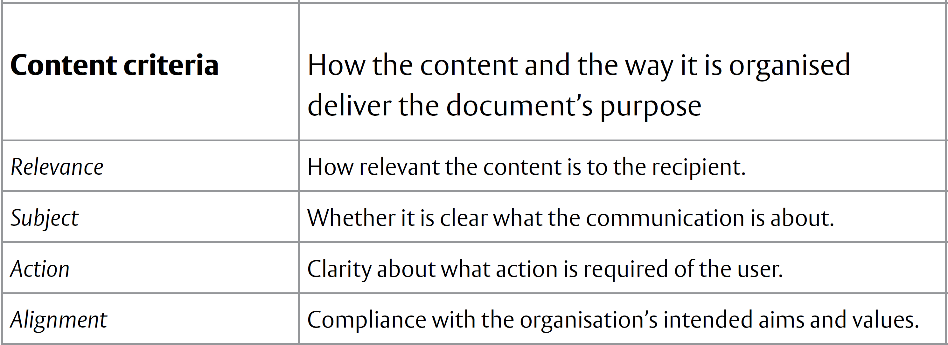
The sixteen criteria

Slide 40
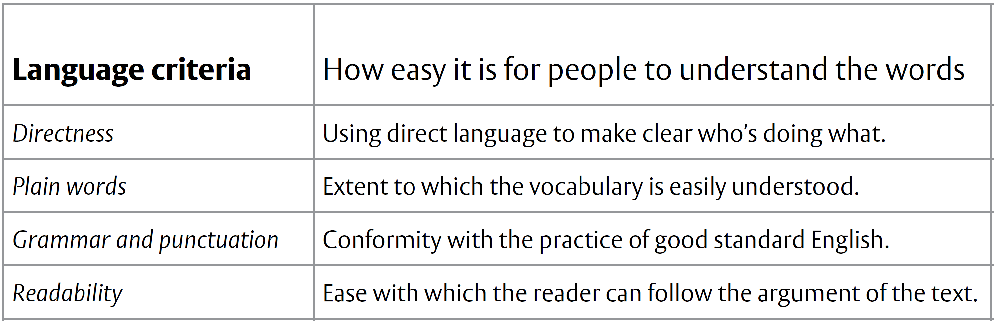
The sixteen criteria

Slide 41
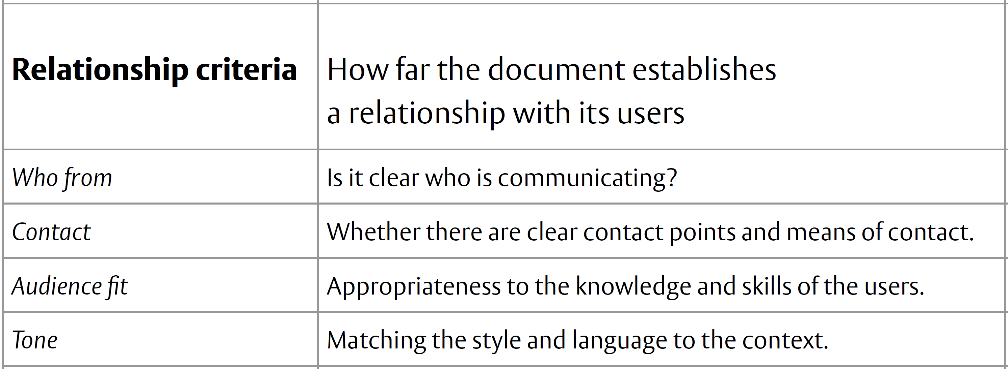
The sixteen criteria

Slide 42
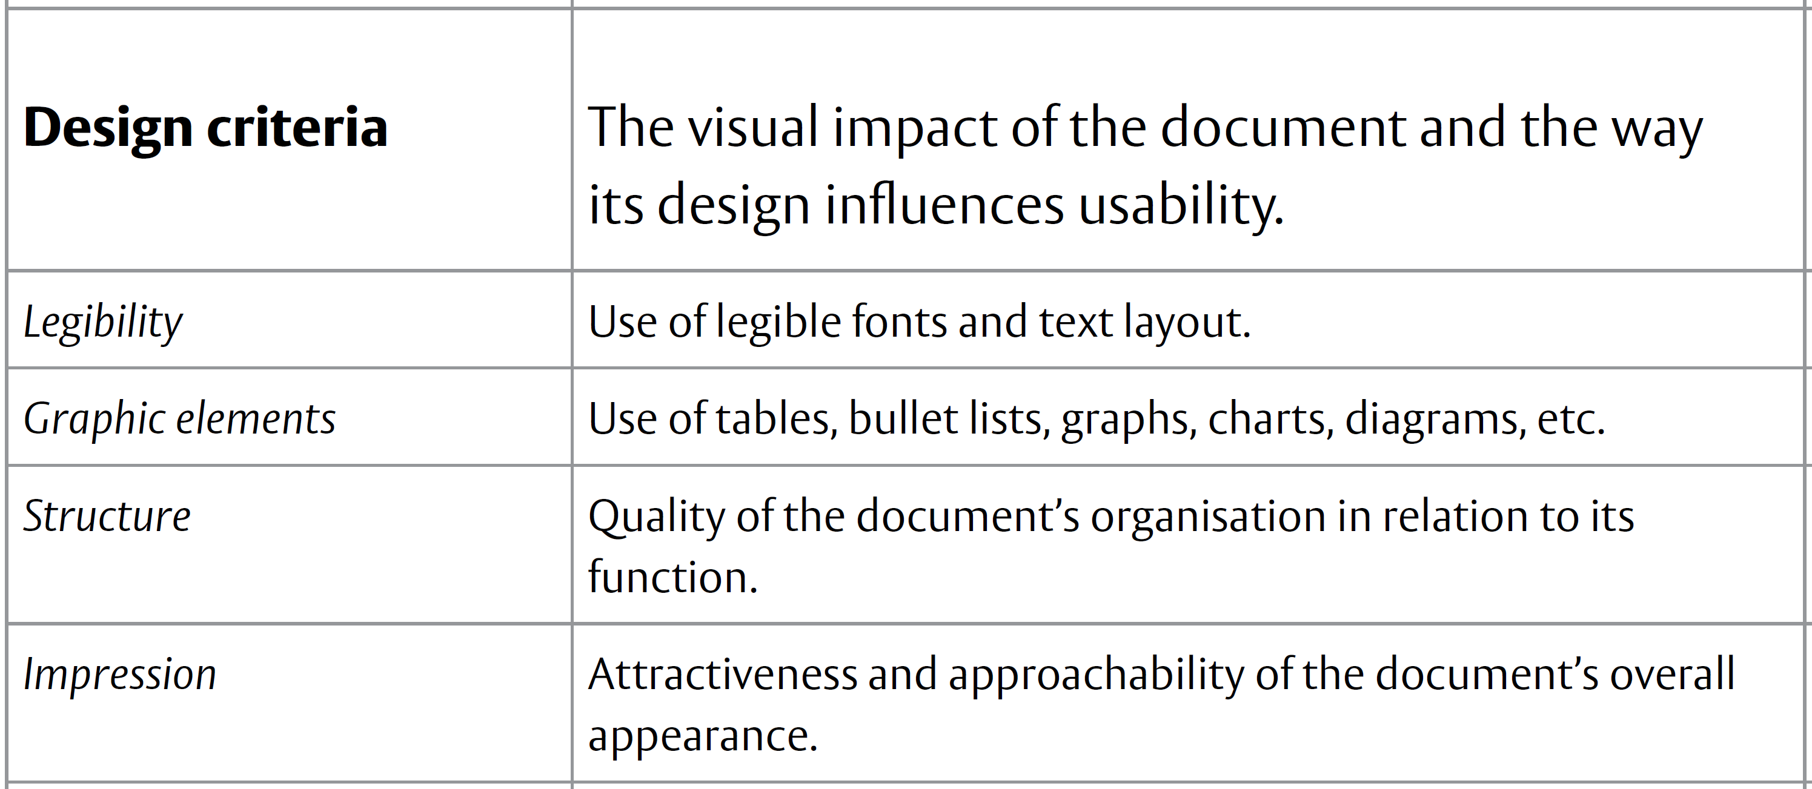
The sixteen criteria

Slide 43
Aspect | General Writing | Technical Writing
Purpose | To entertain and inform | Primarily to inform
Emphasis | General | Specific
Time frame or shelf life | More ephemeral | - More permanent; for the record - Ongoing/multiple/revised editions commo
External validation of writing | Writing is often verified by fact-checkers, editors | Writing (e.g. journal articles) may be reviewed anonymously by referees
Style | -Quotation common -Slang, puns, humor acceptable -Few footnotes, references -First-and second-person references common -Passive voice used less often | -Quotation uncommon -Slang, puns, humor not readily acceptable -Footnotes, references common -First and second-person references uncommon -Passive voice used more oft

